Slide 1
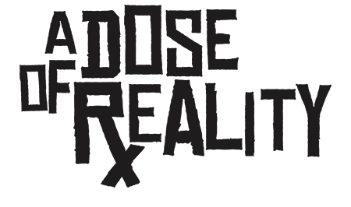

Slide 2
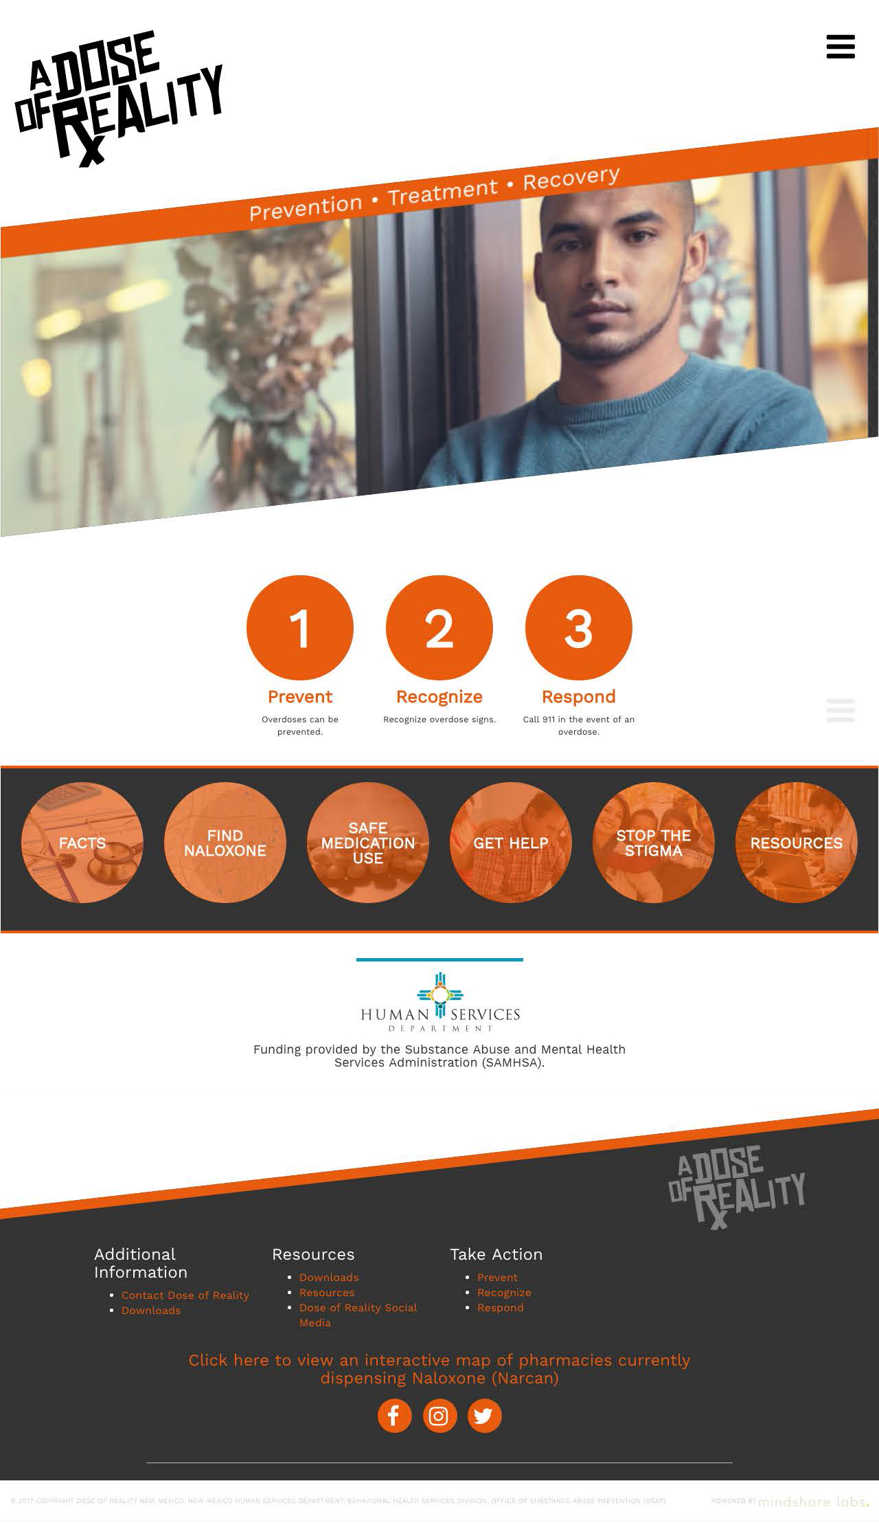
Community Website
www.doseofrealitynm.com
Notes:
Focus group feedback & SEO and advertising - Go to website

Slide 3
@doseofrealitynm
#doseofrealitynm
Notes:
Go to website

Slide 4
Social Media Objectives
Awareness about the following:
● Dangers of sharing medications
● Safe storage and disposal
● Risks of over prescribing to young adults
● Availability of and access to Naloxone (minimal, but is in contract)
Social Media Platforms @doseofrealitynm
● Facebook
● Instagram
● Snapchat

Slide 5
Social Media Platforms @doseofrealitynm
● Facebook
● Instagram
● Snapchat (to be used to create Geofilters)
Hashtag
Campaign hashtag #DoseofRealityNM
We “own” this hashtag as it hasn’t been used on Facebook or Instagram
Topic specific hashtags #DangersofSharing #SafeStorage #PrescriptionRisk #GetNalaxone

Slide 6
A DOSE OF REALITY JUNE & JULY 2017
Facebook Followers: 161
Reach: 24,800
Engagement: 352
Instagram Followers: 58
Reach: 1,157
Engagement: 312
Notes:
Small budget to advertise - boosts, but not part of advertising budget.

Slide 7
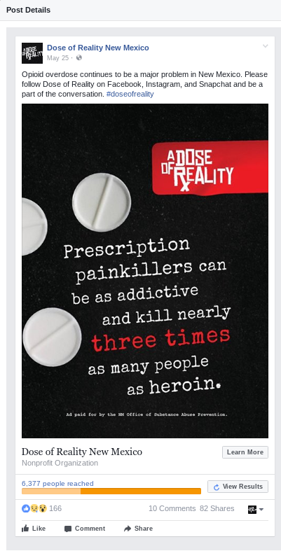
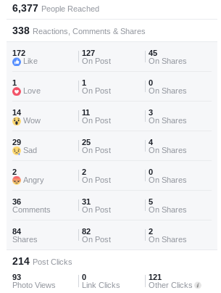
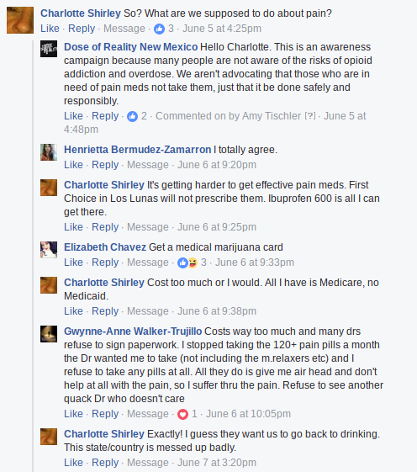

Slide 8
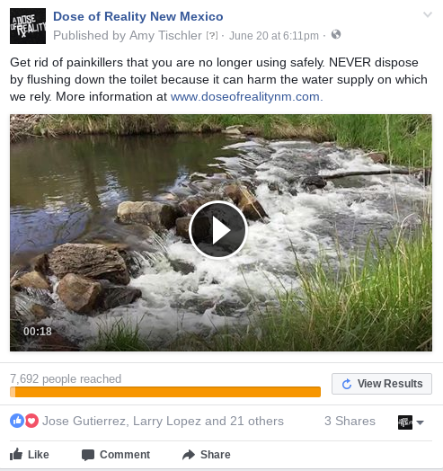
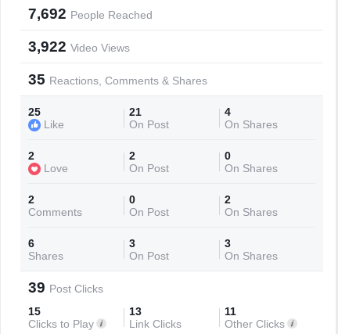

Slide 9
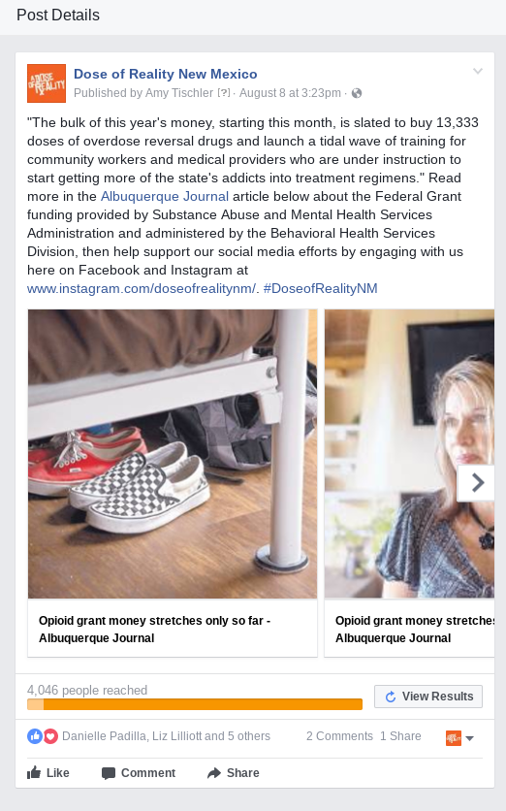
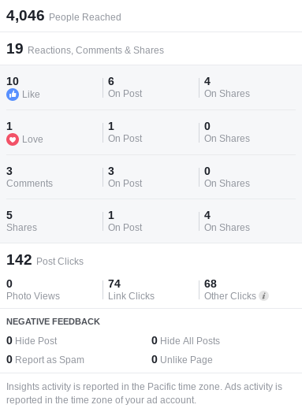

Slide 10
Creative Concepts
Request for testimonials from individuals
In conjunction with the Humans of NM project, request for testimonials from community members will be sought through social media and website submissions to also be used as additional content.
Geofilters – Location based marketing
Geo filters on Snapchat, specifically targeted to geolocations/areas that are affected such as schools, universities, nightlife neighborhoods, sport centers, hospitals, clinics, high risk neighborhoods, etc. Businesses and organizations can purchase On-Demand Geofilters for a specific location.
Notes:
Lessons learned:
What is most important about social media is getting people to engage and have conversations with us, and with each other. This is how you can have the conversations beyond awareness and general education, and get messages out that deal with stigma (DISCRIMINATION) and misinformation. What we are finding very quickly is they are
discussing the continuum from prevention to treatment on their own. We are also getting requests from coalition members to share their program social posts on our platforms. The analytics are starting to give us a better picture of how to move forward.

Slide 11
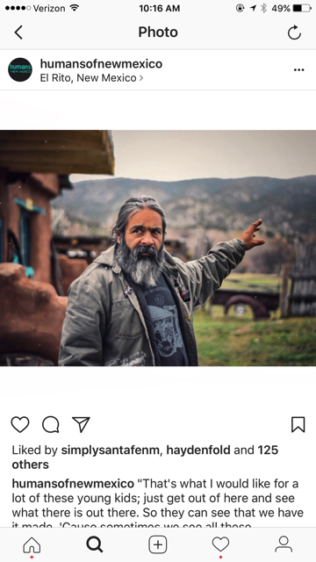
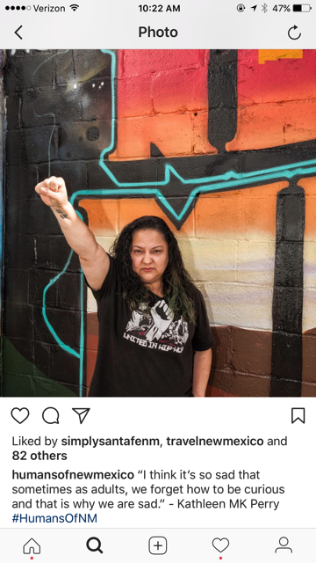
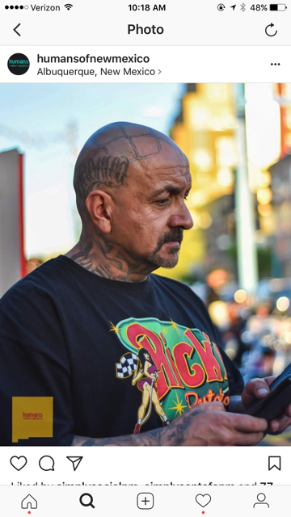
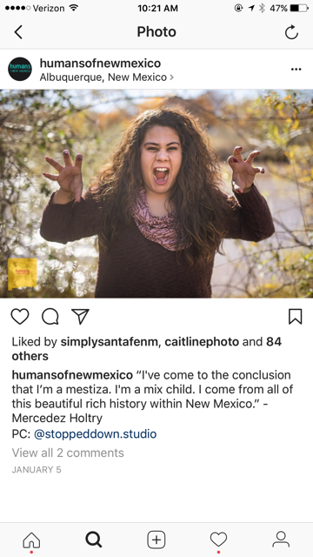
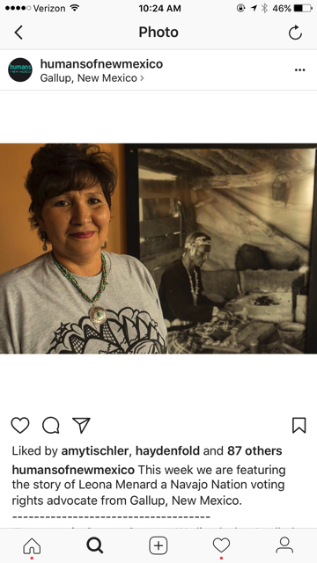
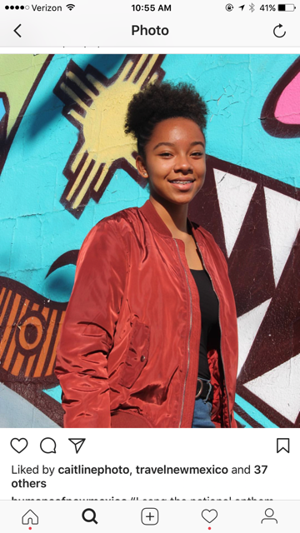
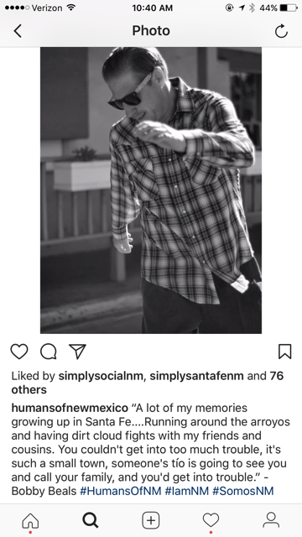
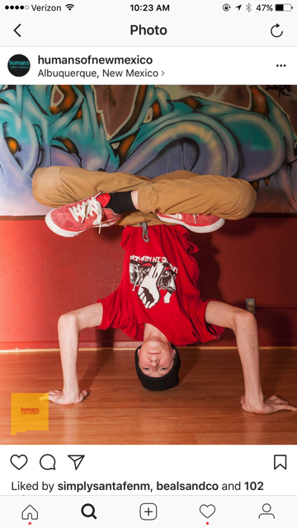
Notes:
“We have a lot of people with traumatic brain injuries in Gallup. Before you know it, people are self-medicating which leads to high alcoholism and drug addiction.” - Leona Menard. “That’s what I would like for a lot of these kids; just get out here and see what there is out there. So they can see that we have it made. Cause sometimes we see all these mountains here and we see ‘em so much that we don’t see ‘em no more”. - Nicholas Herrera “I went to kindergarten in a lowrider. My dad had cars slammed to the floor. My brother. My uncles. Since the 40s it’s non-stop.” - Sparky “Burque is a rough town. There’s a lot of bad that happens here, but in my heart I know there’s more good that tops that bad. Writing about the pain that we face is so important - it helps us heal and find closure but it helps us expose the heartache that we need to constantly work on”. - Mercedes Holtry “I sang the national anthem for the sports games at my school. I saw what Kaepernick did. He inspired me a lot, because he opened my eyes and I wanted my school to do the same. So I decided when I sange the national anthem for a volleyball game I would kneel.” - Chloe

Slide 12
LIVED EXPERIENCE STORYTELLING
www.humansofnewmexico.com
This is HUMANS OF NEW MEXICO.
A communal effort to record and showcase the lived experiences of everyday folks in New Mexico. In so doing, we hope to bring attention to the complex issues that affect our communities and offer a platform to voice everyday practices of resistance to societal pressures.
The site serves as an online archival interactive project which prioritizes textual and audio testimonial components along with photographs.
We invite our viewers to engage in critical testimonial practice by engaging with textual, audio and visual analysis of the diverse communities whose stories we share.
Notes:
Humans of New Mexico is a not-for-profit project which highlights individuals in the state and shows the diversity of the population. It is a community-wide effort to capture the complex issues that affect our communities and offer a platform to voice everyday practices of resistance to societal pressures. We recognize that New Mexico has diverse cultural traditions; therefore, we are interested in capturing snippets of communities that have been here for generations as well as new populations contributing to our state. Agency through testimonio practice is at the heart of this project. We strive to privilege oral and language traditions by incorporating each storyteller’s native textual language as much as possible.
Humans of New Mexico Mission Statement

Slide 13
Creative Concepts
Testimonial collection collaboration project with Humans of New Mexico Collective
Portraits of people in their environment who are currently or potentially affected by opioid usage including testimonials about why these issues are important to them.
Teacher, Parent, Significant Other, Grandparent, Business, Roommate, Healthcare Worker, Etc…
May be able to tap into relationships that the Collective have already cultivated through previous interviews to find subjects for the project.
Work collaboratively with the Collective to capture these stories through still imagery, video, audio, and text. Content will be published on Dose of Reality and Humans of NM social media platforms and websites. The Collective currently has 4,343 Facebook followers and 2,103 Instagram followers. *All content will be approved before publishing on either platform.
Humans of New Mexico hosts a weekly 30 minute radio show on KUNM Public Radio station 89.9. Potential to have audio clips of our interviews aired during this time.
Physical exhibit of imagery and stories after all the stories have been published online. An opening reception of this event could be an opportunity to connect with various members of communities in a real life setting.
Notes:
Lessons learned:
What is most important about social media is getting people to engage and have conversations with us, and with each other. This is how you can have the conversations beyond awareness and general education, and get messages out that deal with stigma (DISCRIMINATION) and misinformation. What we are finding very quickly is they are
discussing the continuum from prevention to treatment on their own. We are also getting requests from coalition members to share their program social posts on our platforms. The analytics are starting to give us a better picture of how to move forward.

Slide 14
Earned Media Creative Concept
Telling the prevention, treatment and recovery (continuum) story
“Day in the Life Of” Continuum Champions:
Prevention - Bernie Lieving
Recovery - Mark Garnand
Treatment - Leslie Hayes
Notes:
Filming

Slide 15
Next Steps
Encourage social media sharing among adults 18+ who are some of the most active users of these social networks.
Create a distinct section on our ADOR website to educate and encourage discussion (In process)
Visually record and utilize real stories from New Mexicans in our social and PR campaigns to bring a "human element" to the advertising messaging. (In process)
“I am your neighbor, your teacher, your daughter. You smile at me in the park. I am all of those things. I am also a recovering addict. Who knows, you might be at risk for becoming an addict too. So, if you’ve just finished your first prescription of opioid pain medication, think hard before getting more. The euphoria you feel now will go away and your soul will go with it. And if someone suggest medication assisted treatment, jump at the chance. I promise, it will be worth everything to you and those you love. “
Engage with social media influencers to create content that will positively impact our target via social media, where they rely on influencers for their information and opinions.
Notes:
Social media influencers generally have a large following, which means that through them you can reach a wide audience. If they mention your initiative, they are amplifying your reach and spread of information.
Perception of harm and sharing of Rx opioids
Proper and safe storage of Rx opioids
Harm risk of Rx opioid misuse, abuse among youth, parents, and young adults
Audiences: Anyone at risk of overdose, first responders (all) and organizations that work with addiction

Slide 16
Content Needs
Photographs
Videos
Articles
Cross-promotion
Content from other states/organizations with similar campaigns
Ask friends/followers to share and promote
Share with Simply Social Media at hello@simplysocialmedianm.com
Notes:
We will review to ensure it meets the contract needs and social platform requirements.

Slide 17
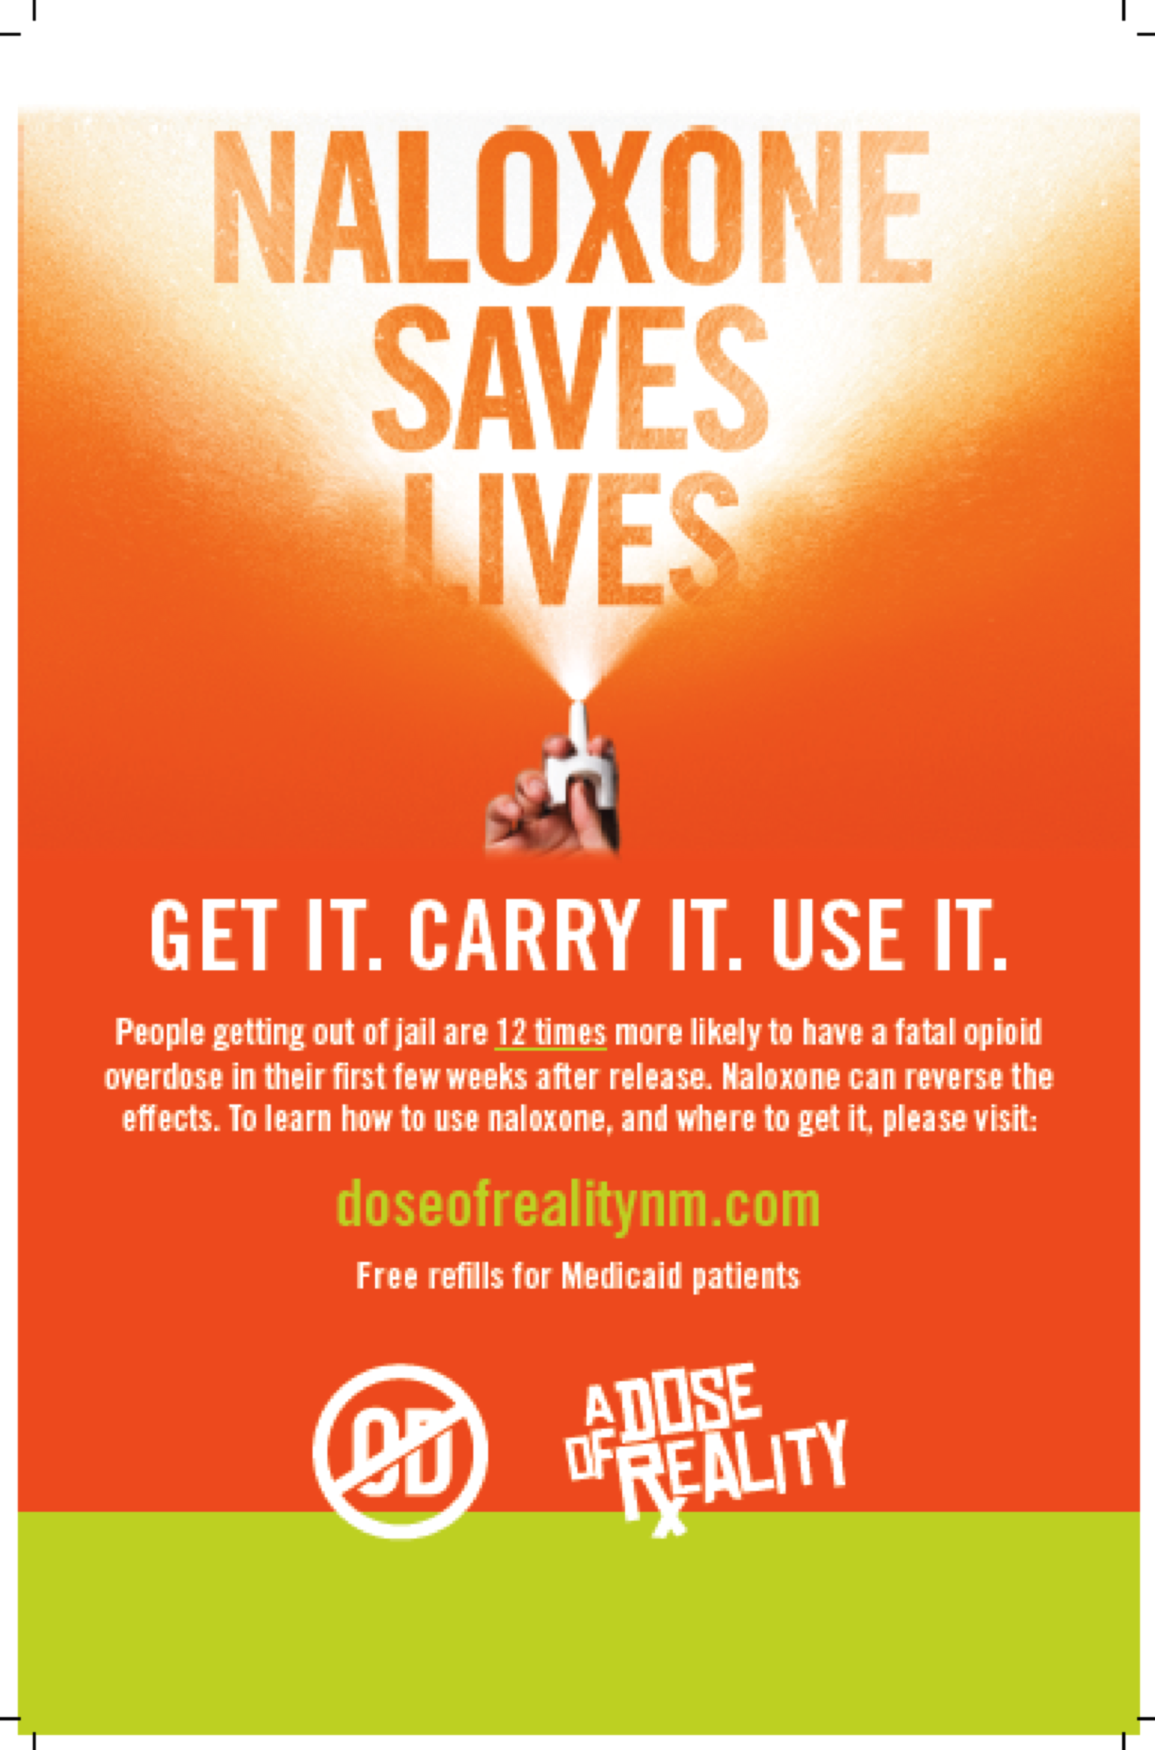
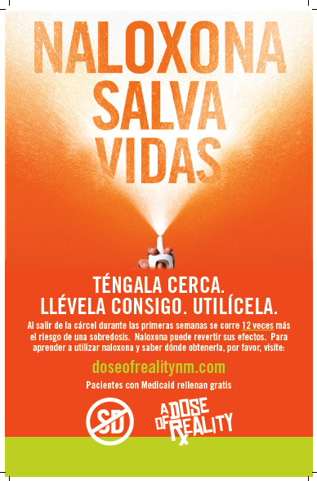

Slide 18
STR
Adapt and expand the existing PR “A Dose of Reality” (ADOR) campaign for:
Prescribed and illicit opioid prevention
Treatment and recovery activities for opioid use disorder (OUD) to emphasize a Network of Care.
Our marketing program will educate, raise awareness and promote activities to:
Address barriers to receiving treatment by reducing the cost of treatment
Promote the developing systems of care to expand access to treatment, engage and retain patients in treatment
Address discrimination associated with accessing treatment, including discrimination that limits access to MAT.
Support innovative telehealth in rural and underserved areas to increase capacity of communities to support OUD prevention and treatment.
Support access to healthcare services, including services provided by Federally certified opioid treatment programs or other appropriate healthcare providers to treat substance use disorders.
Notes:
Regardless of contract, the earned and owned media must address the continuum. It is seamless to the audience.

Slide 19
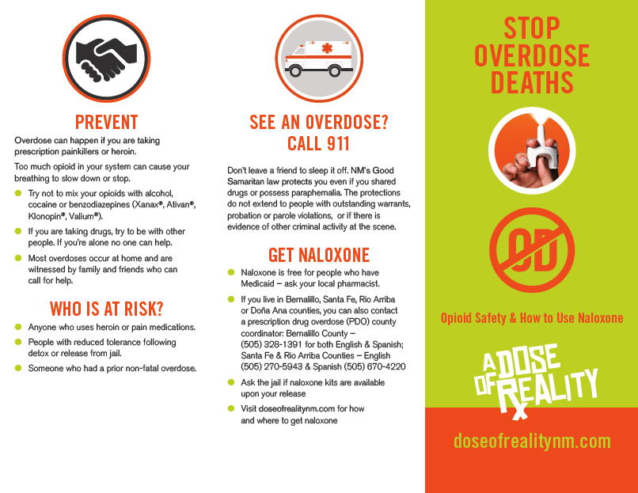

Slide 20
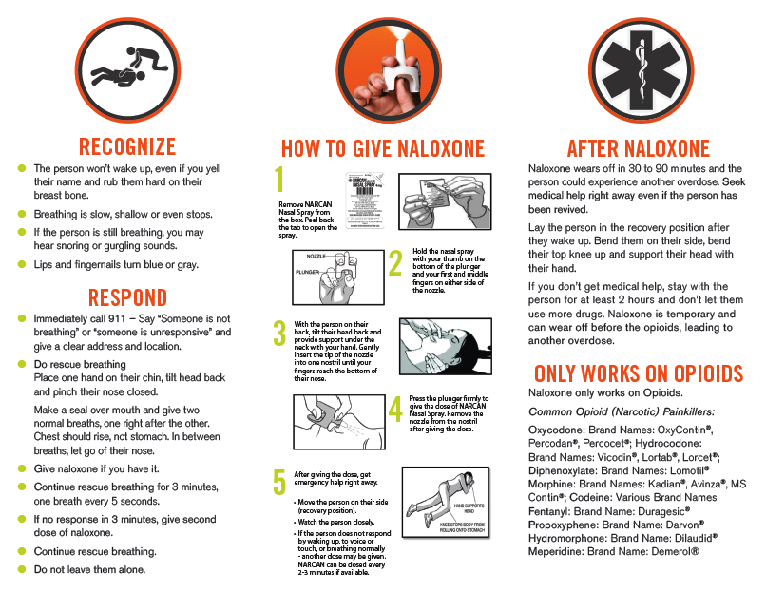

Slide 21
Questions?
PK Public Relations
Lynn Pitcher Komer
(505) 660-7682
lynn@pkpublicrelations.com
Notes:
Share with Simply Social Media at hello@simplysocialmedianm.com

